Slide 1


Working in the Software Industry
UCC Computer Science, Feb 2016

Slide 2
Agenda
Roles in Software Engineering
Skills as Software Engineers
Industry Trends
How/Where we work - Our Office
Q&A
^
New

Slide 3
Roles in the Software Industry

Slide 4


Slide 5
Skills as Software Engineers

Slide 6
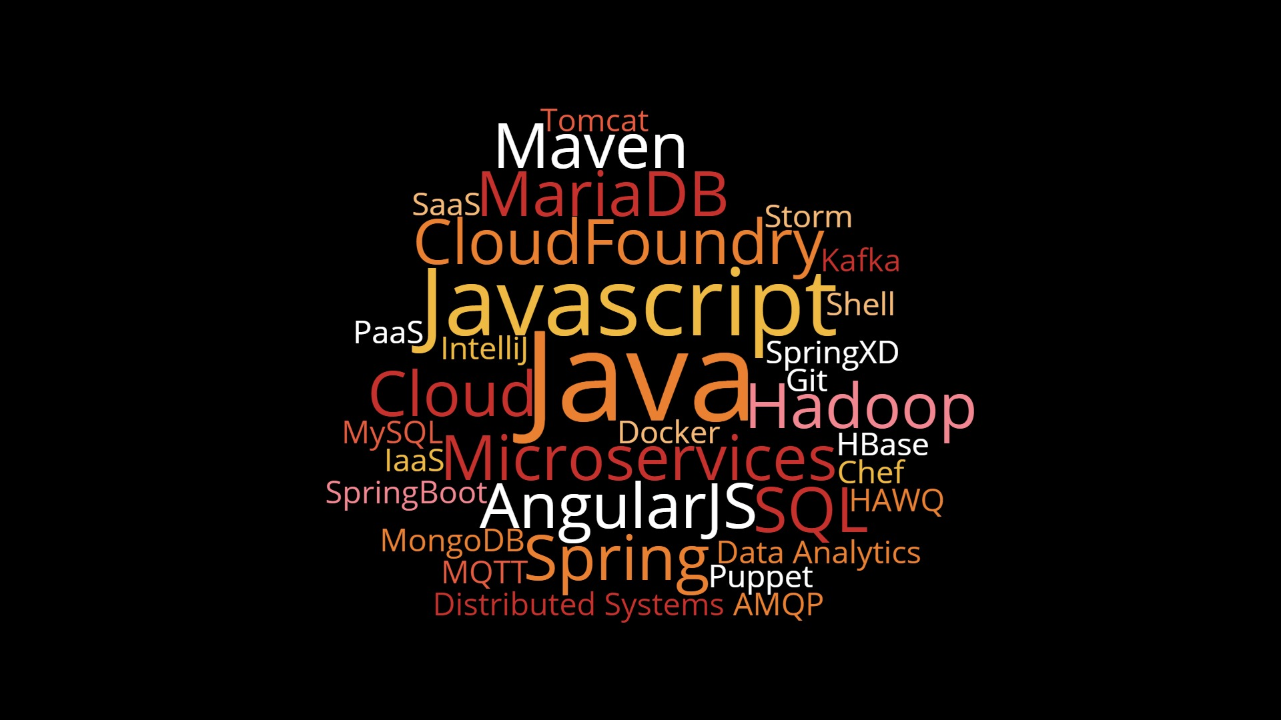

Slide 7
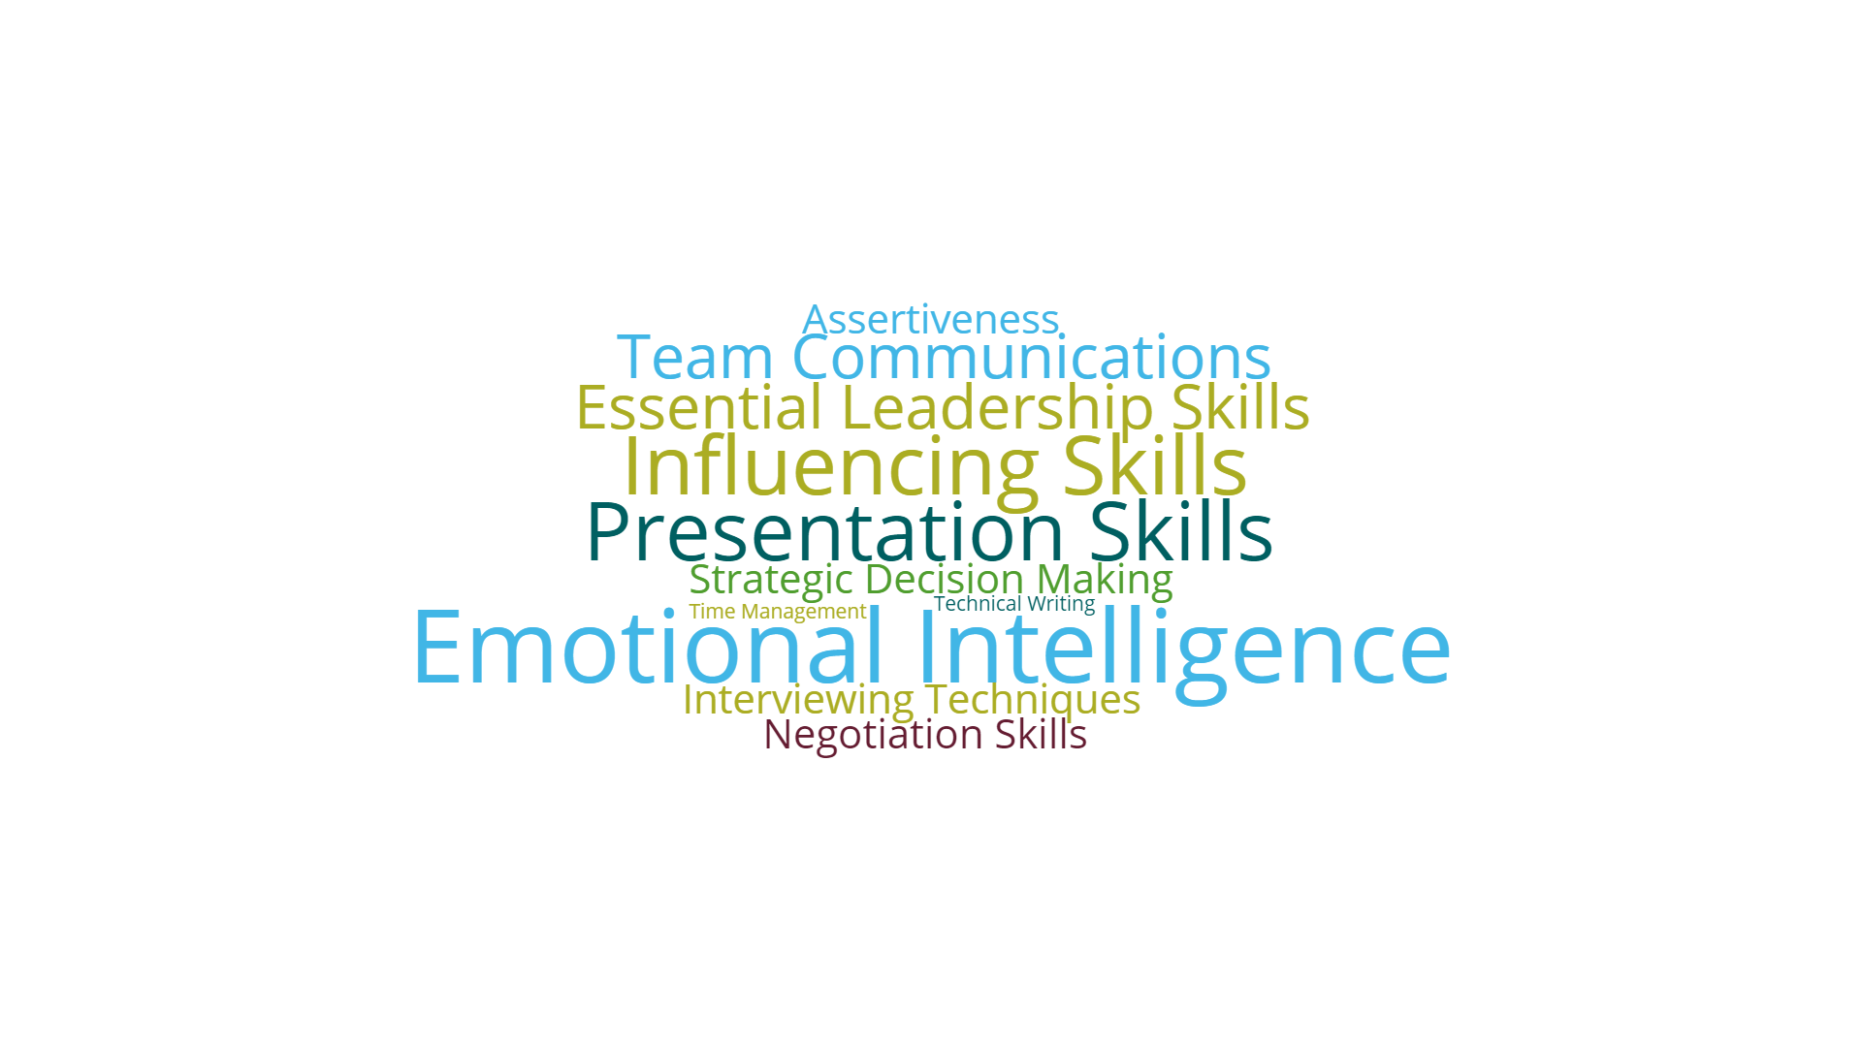

Slide 8
Industry Trends

Slide 9




Cloud
Social
Mobile
Big Data

Slide 10
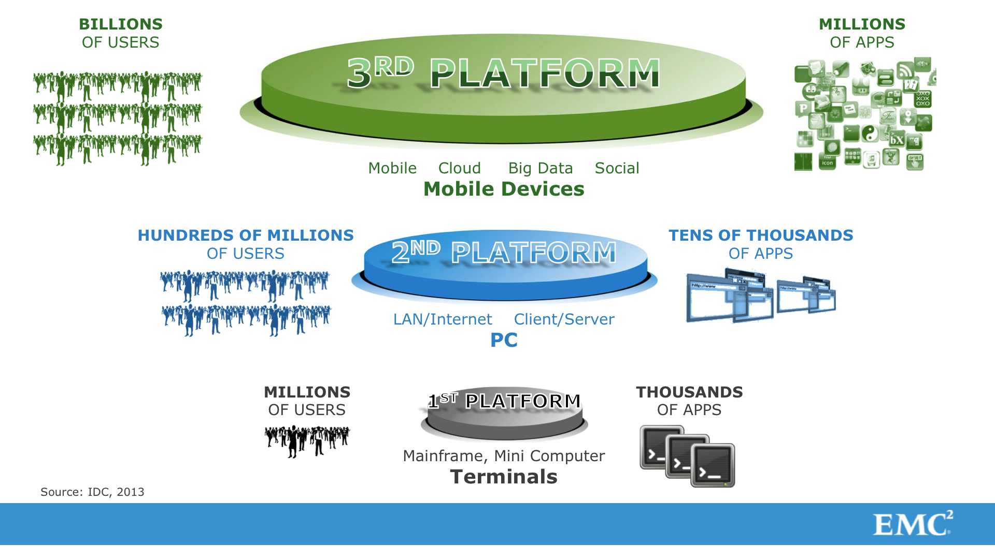

Slide 11


Slide 12
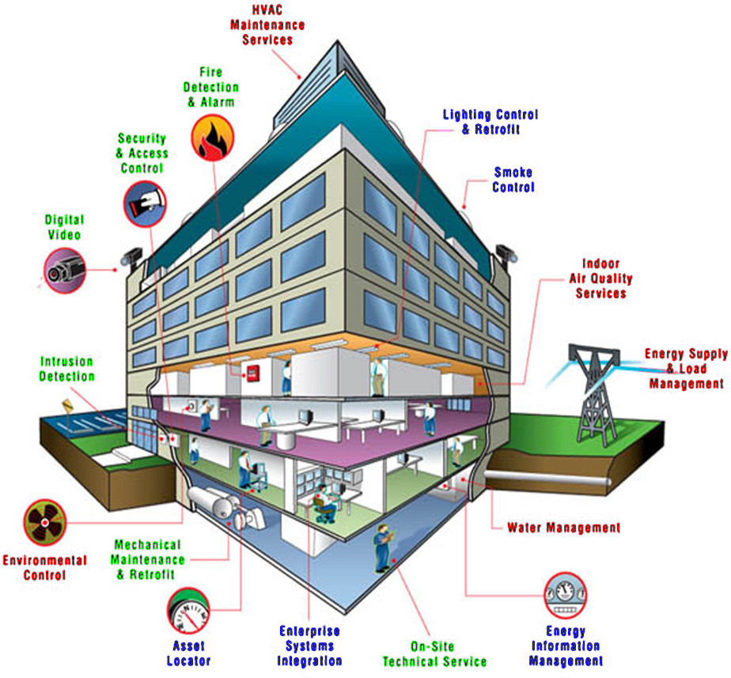





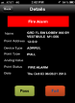





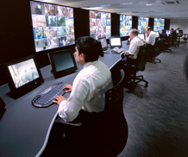
// Smart Buildings
Customers
Service Techs
Smart panels
Laptop / PC
Mobile devices
Interactive
Storage
Analytics
Compute
TycoNet
Cloud Services
Wired & wireless communication
Command center

Slide 13
How we work

Slide 14
Mobile
Workforce
External
Location
Office
Based
Remote
Worker
Laptop
(Workstation)
Mobile
Phone
Web-based
Tools
(e.g. Jira/Confluence/Stash)
BYOD
VPN
Collaboration &
Communication
Tools
(e.g. WebEx, GoToMeeting)
Visiting
Office
Working
From
Home
Visiting
Vendor/Client

Slide 15
Where we work

Slide 16





Slide 17
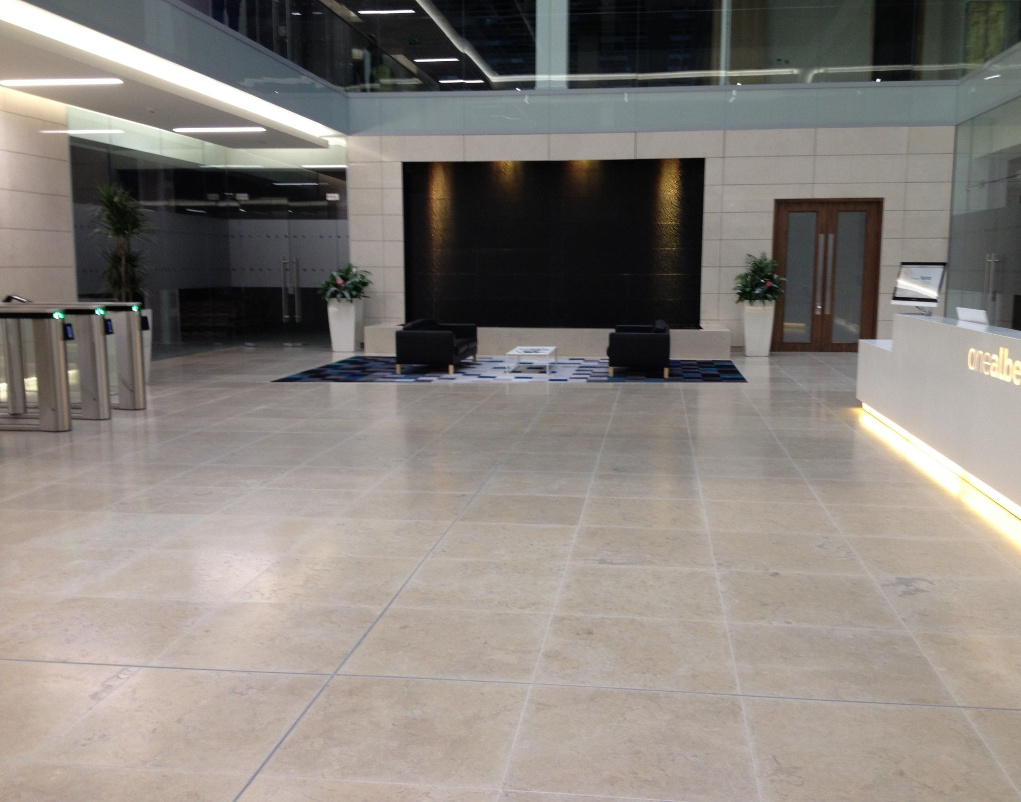

Slide 18


Slide 19
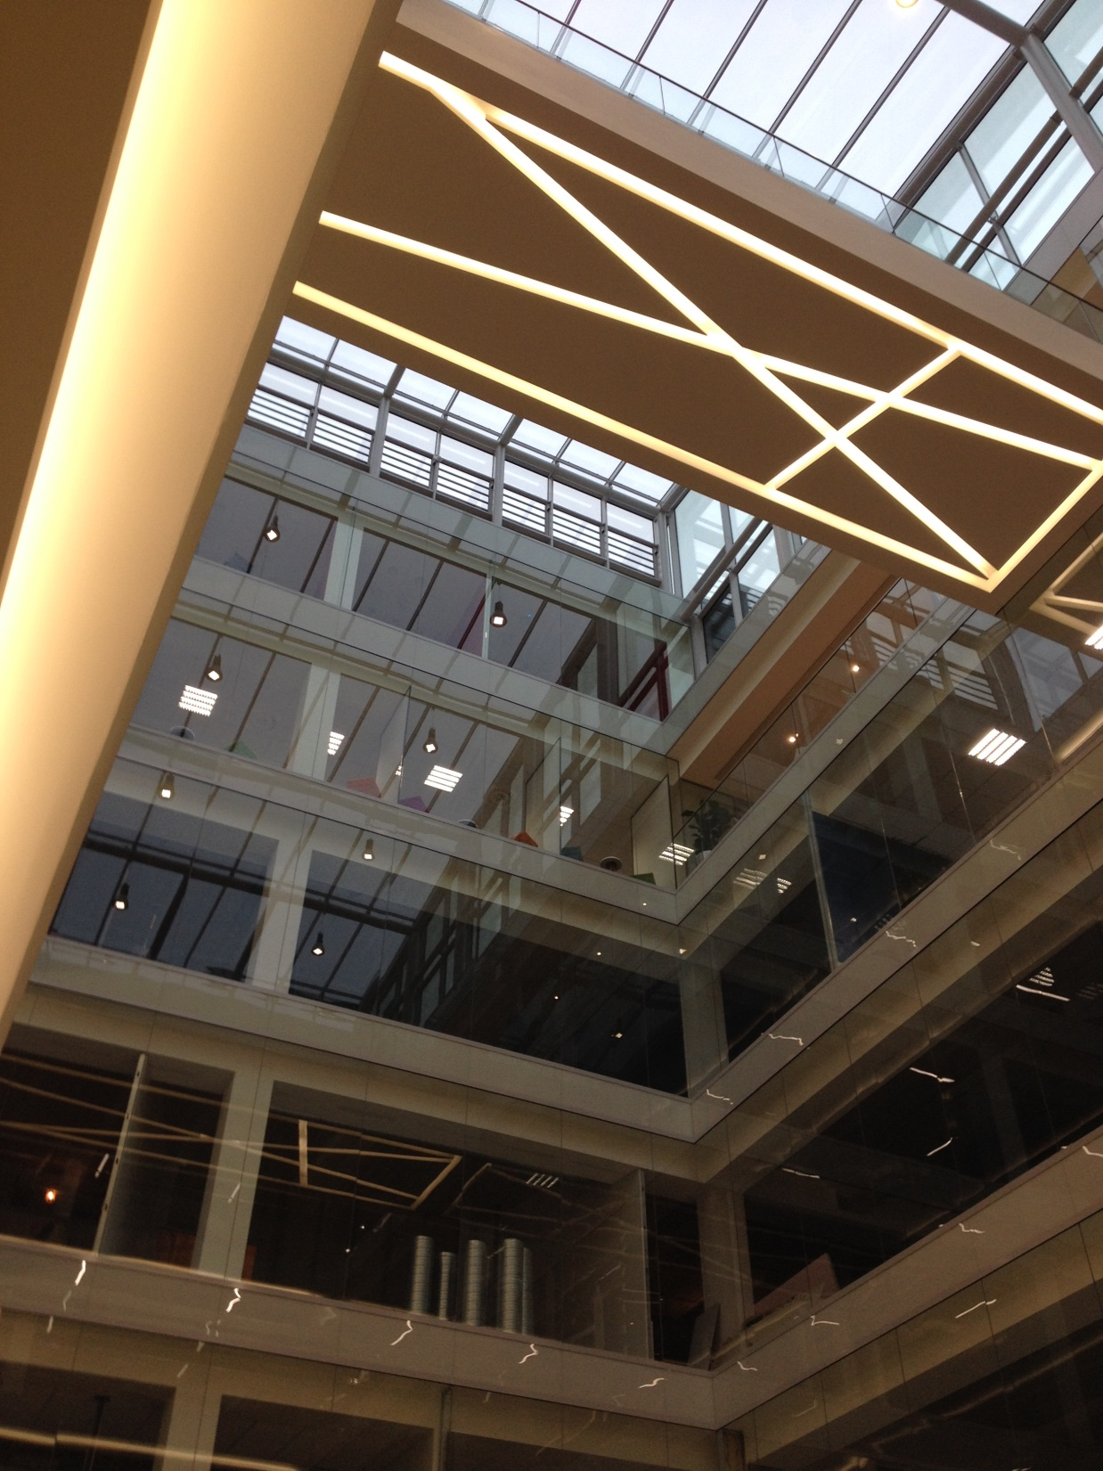

Slide 20
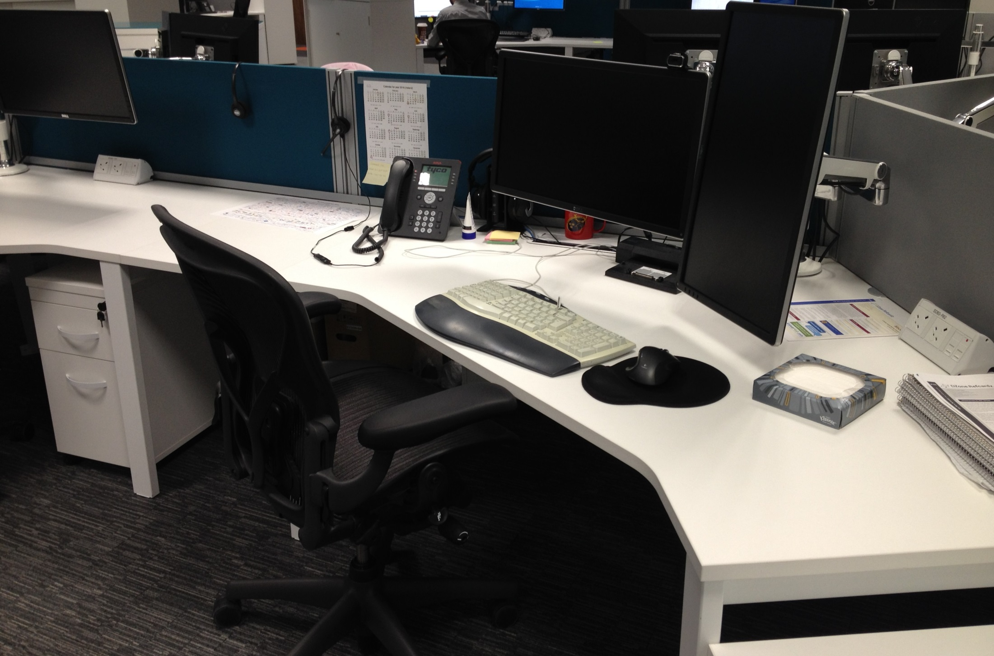

Slide 21
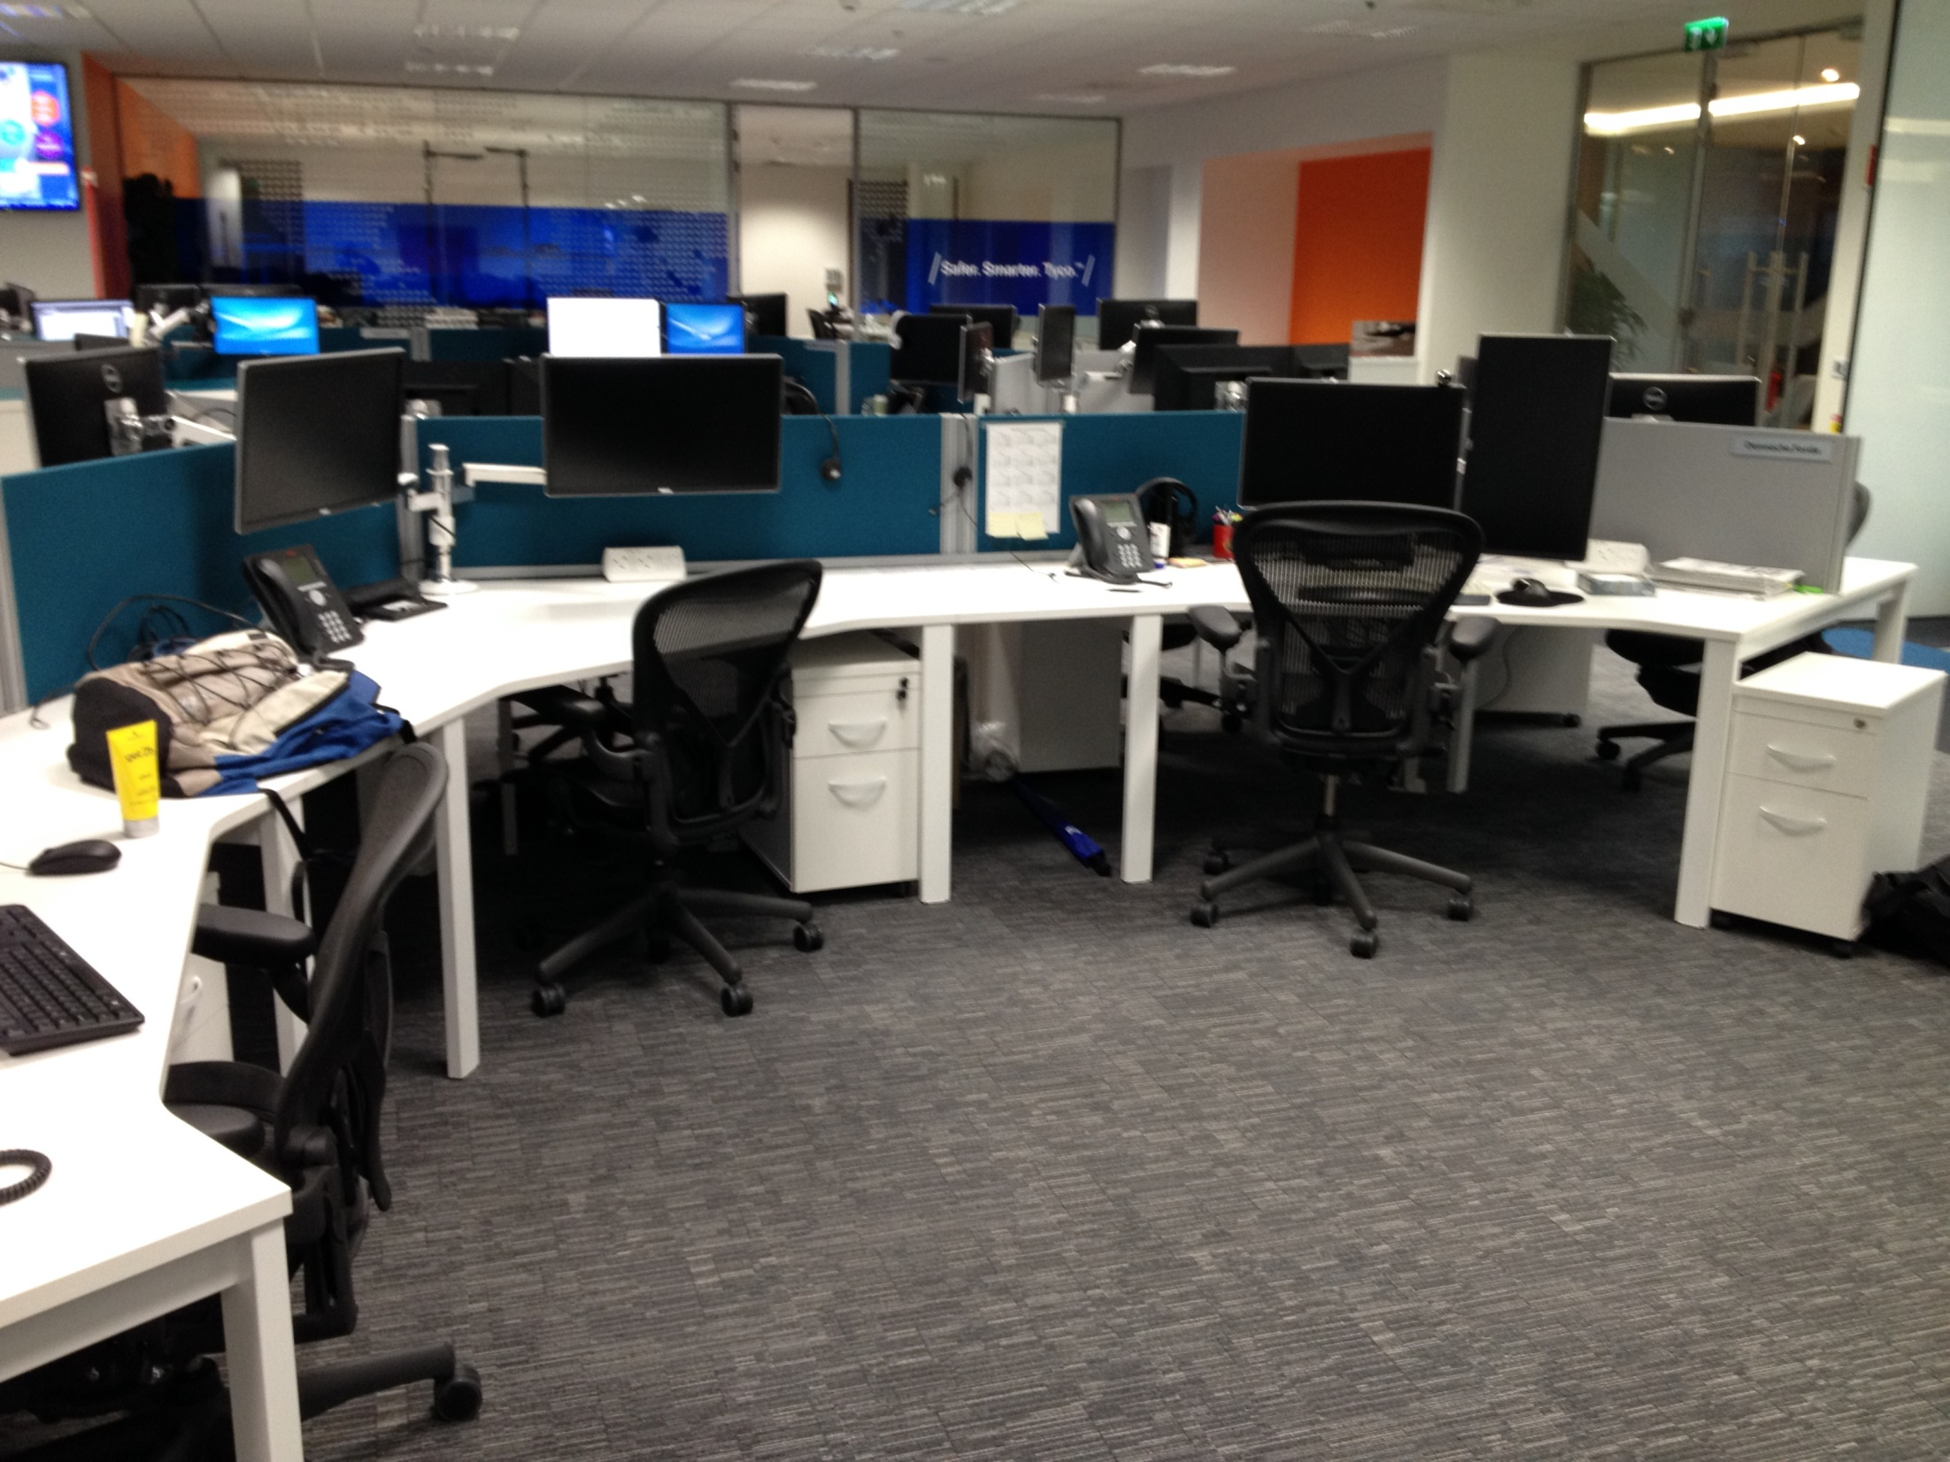

Slide 22
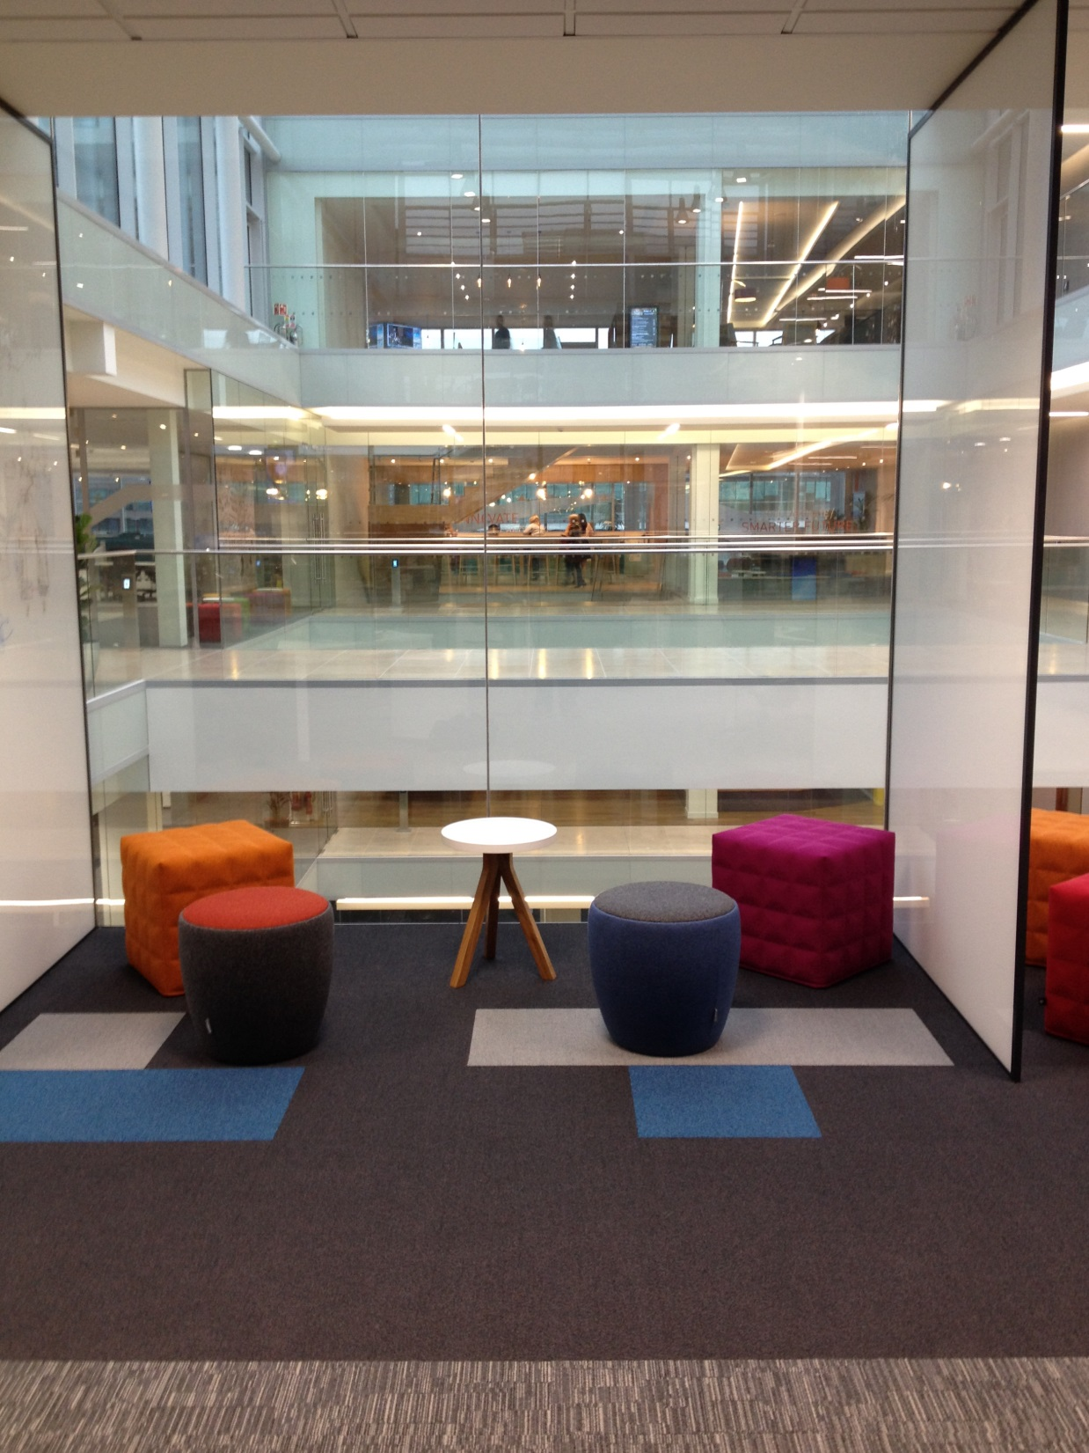

Slide 23
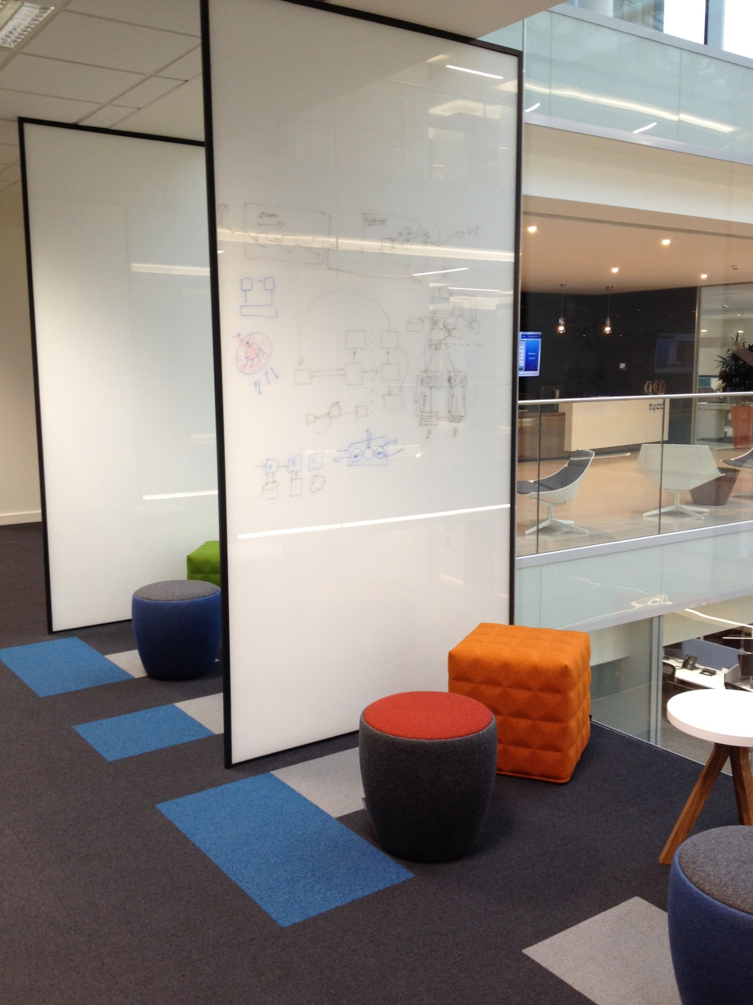

Slide 24
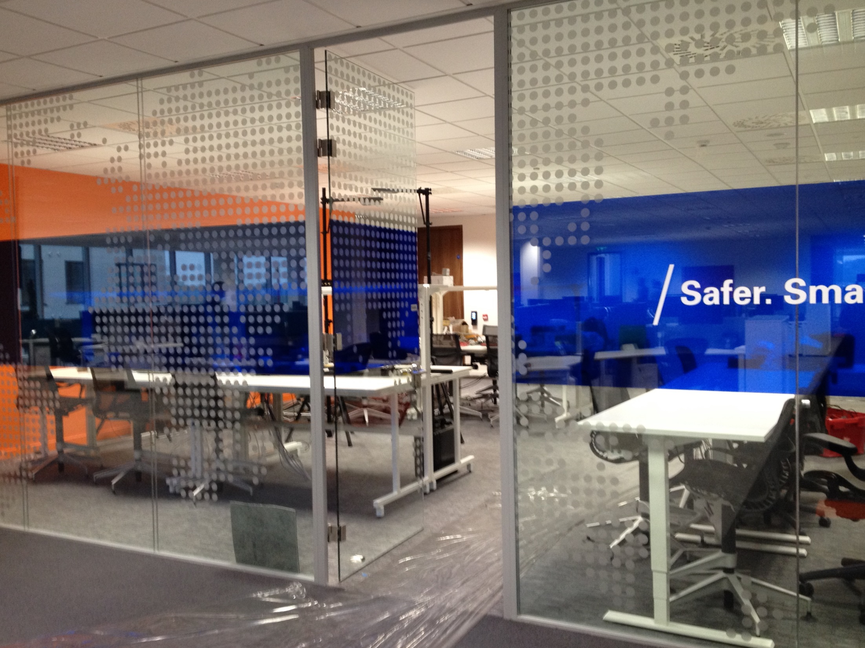

Slide 25
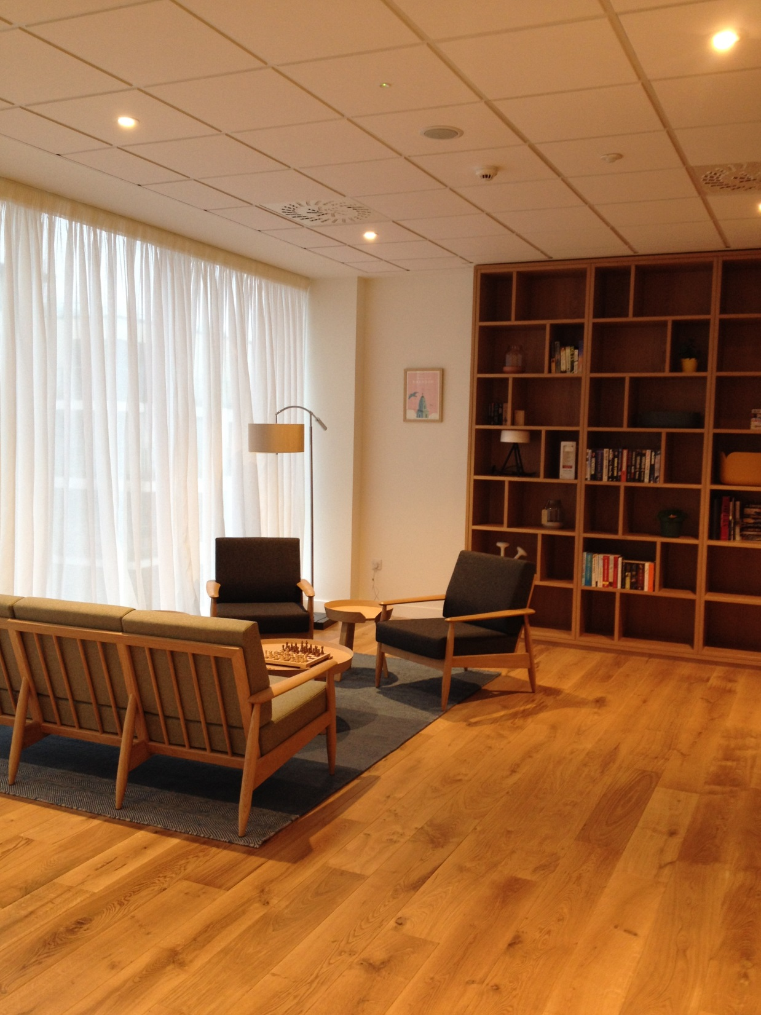

Slide 26



Slide 27

Questions for you
Do you like building User Interfaces?
Are you good at debugging?
Do you like testing?
Are you a systems programmer or an application programmer?
Are you an architect or coder?
Do you want long-term or short-term projects?
Does management interest you?
Do you want to work for a big company?
Do you want to work on open-source projects?
Do you want to work for a small company?

Slide 28
Thank You
UCC Computer Science, Feb 2016

